Slide 1


ONLINE AUCTION PLATFORM
BABYCORP
BY SHIRSA MONDAL & TANNISTHA NEOGY

Slide 2
INTRODUCTION
In the dynamic landscape of e-commerce, where convenience and choice are paramount, we present "BabyCorp" – your one-stop destination for all things baby-related. Our online web application is dedicated to simplifying the lives of parents, caregivers, and anyone seeking the best for their little ones.
This project report delves into the concept, development, and potential impact of BabyCorp, an innovative web application that has been meticulously designed to serve the ever-evolving needs of those caring for infants and toddlers. From an array of cozy clothing and nursery essentials to innovative gadgets and feeding solutions, BabyCorp offers a thoughtfully curated selection of baby items that cater to both practicality and comfort.

Slide 3




HTML
CSS
JAVASCRIPT
PHP
SQL
PHPMYADMIN
TECH STACKS

Slide 4
FEATURES
User Registration & Login
Admin Login
Bid on Products
Browse and Search Products
Categories Listing
Products Listing
Account Termination
Change System Settings
Manage biddings

Slide 5
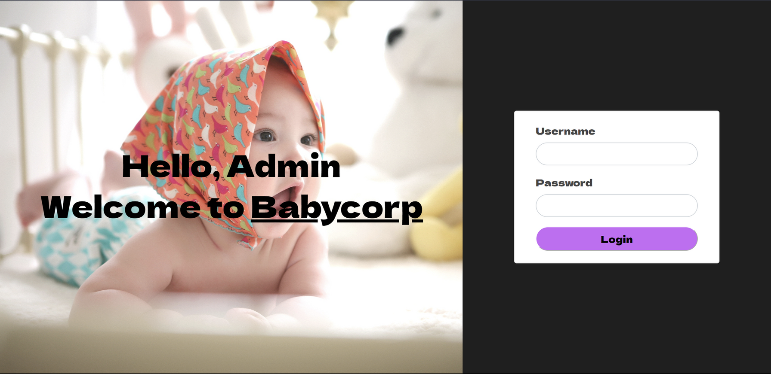
WEBSITE PREVIEW

Slide 6
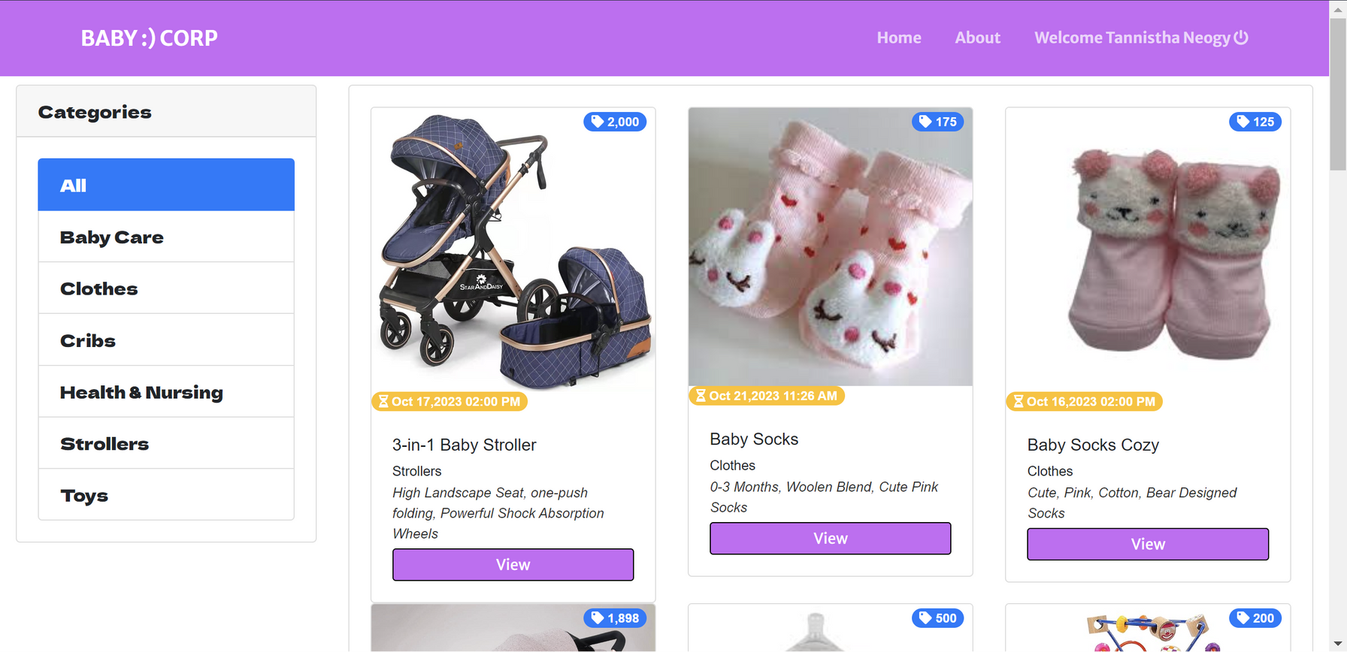
WEBSITE PREVIEW

Slide 7
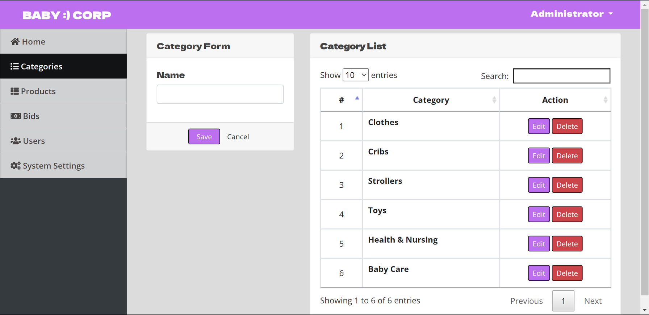
WEBSITE PREVIEW

